Slide 1
A Holistic View on Machine Learning for Systems
Yi Ding
MIT CSAIL

Slide 2




Notes:
I don’t think I need to pitch these modern applications: chatbots, AI-powered search engine, metaverse, and webservices. We see them all over the news. But, what is interesting is that these are all highly complicated computing systems.

Slide 3


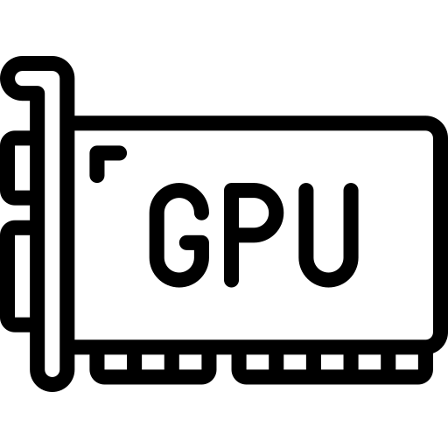





Heterogeneous
Hardware
Highly Diverse and Configurable Software
Multiple, Conflicting System Goals
Performance
Energy
Accuracy
Security
Notes:
For hardware, these systems have moved away from CPU designs to heterogenous systems such as GPUs, FPGAs, and application-specific integrated circuits to accelerate computing. Besides hardware systems, software systems are also highly diverse and configurable that have hundreds of configuration parameters, which are impossible to tune them manually. In addition, modern computing systems must meet multiple and even conflicting systems’ goals such as performance, energy, accuracy, and security. All these complexities from hardware and software systems are up to users to manage to drive the system to its goals.

Slide 4
How do we manage computer systems given such complexities?

Slide 5
Computer Systems Management
Observe
Model
Optimize
Intervene
Measure system behaviors
Predict system behaviors of potential interventions
Iterative Process
Decide the best intervention to meet system goals
Act on the system
Notes:
To answer this question, system researchers have developed a 4-step process to manage computer systems. The 4 steps are
Note that this process is iterative that we can keep improving system outcomes continually.

Slide 6
Machine Learning (ML) for Systems
Observe
ML Methods
Optimize
Intervene
Iterative Process
Address Complexity to Build Systems Efficiently
Notes:
Recent years have witnessed an increasing amount of work that use ML methods to predict system behavior and meet system goals. This line of research is called ML for systems. The benefit of…

Slide 7
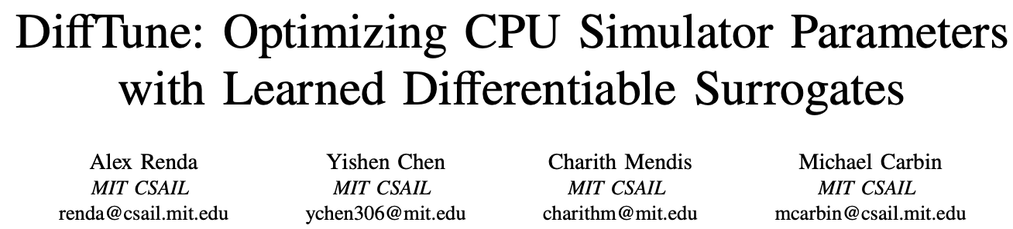

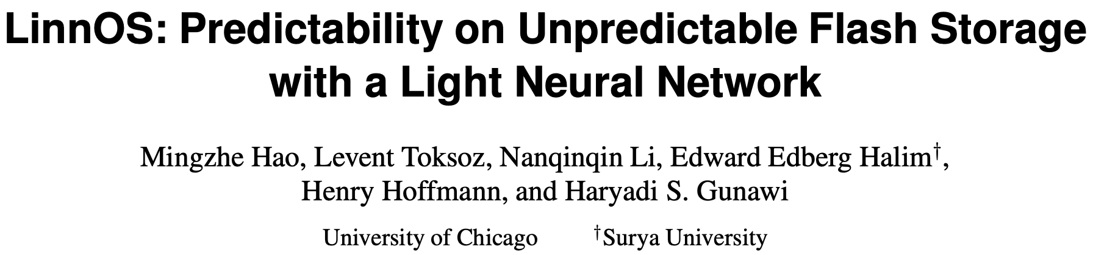
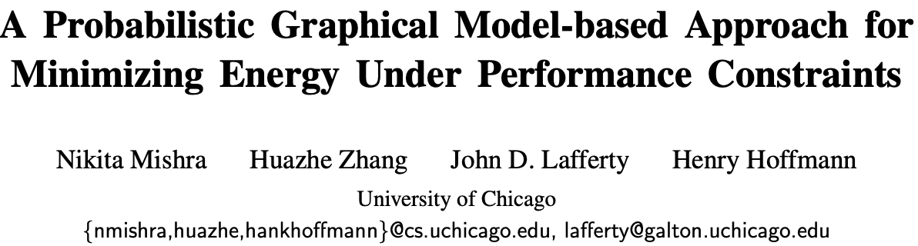

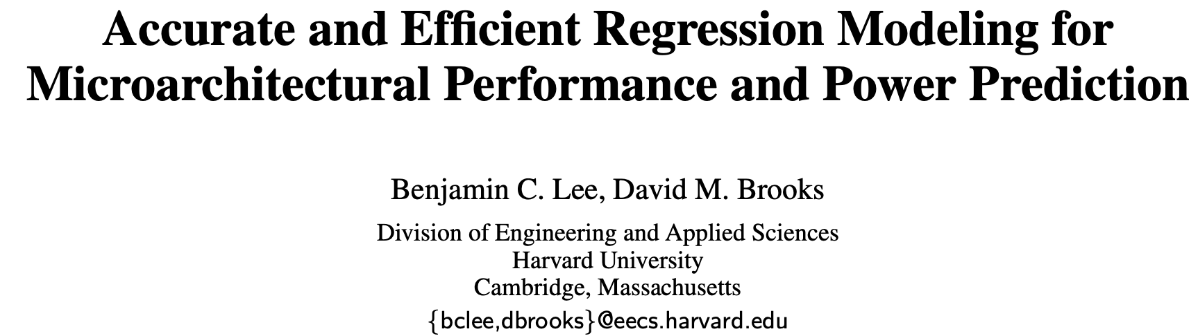
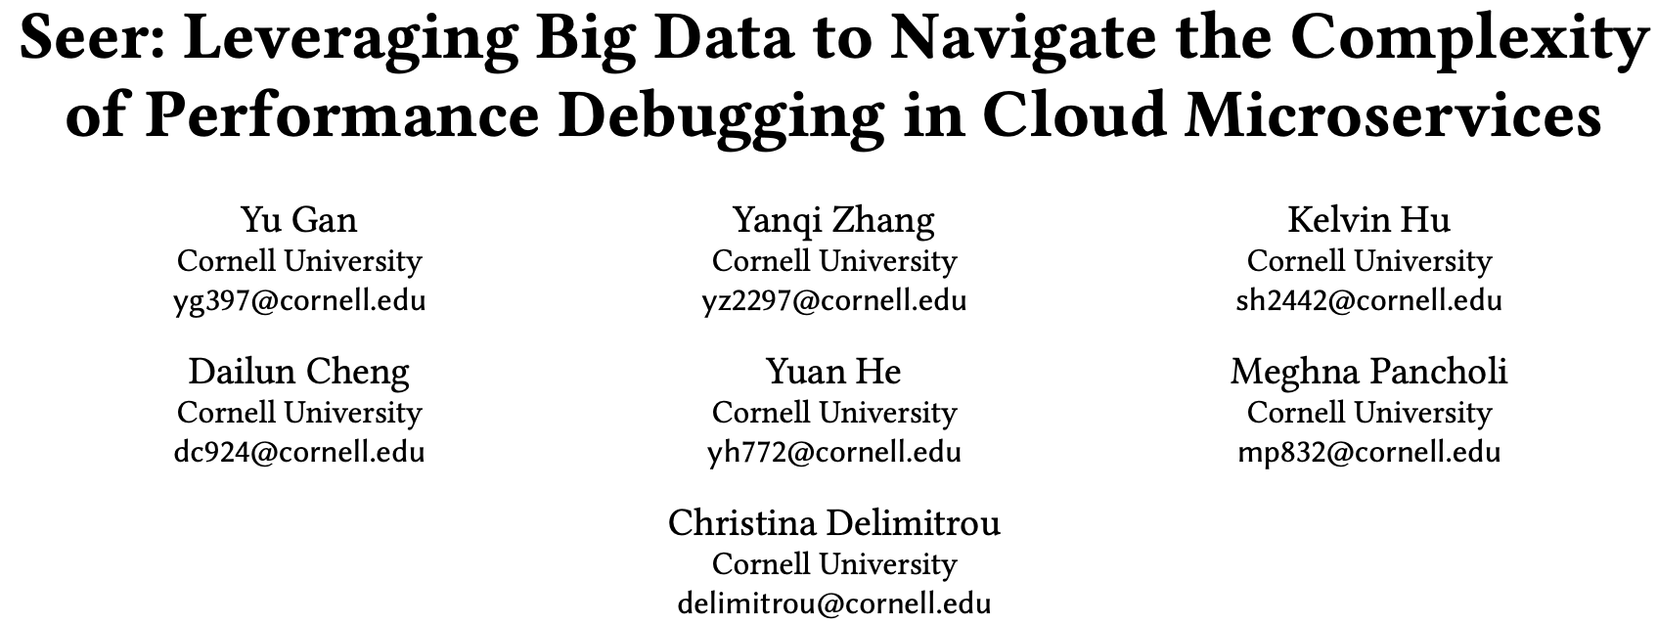
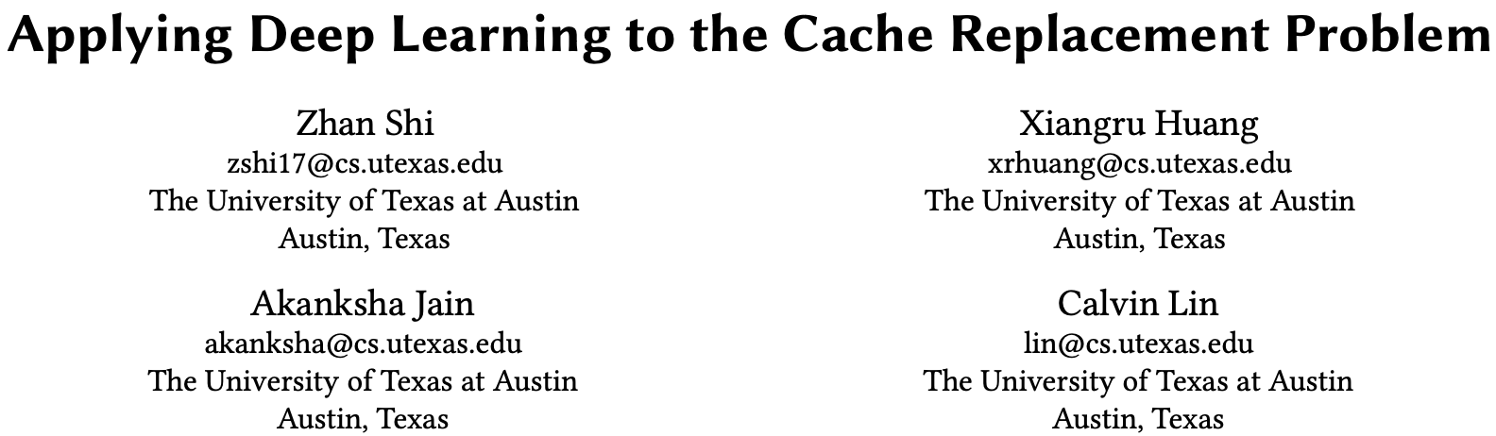
Observe
ML Methods
Optimize
Intervene
Notes:
In the line of research on ML for systems, much prior work has focused on the model stage to improve prediction accuracy of ML methods, by trying different model architectures and learning algorithms.

Slide 8
Does maximizing prediction accuracy of ML methods always give the best system outcome?
Not necessarily
Notes:
However, does maximizing prediction accuracy of ML methods always give the best system outcome? Not necessarily.

Slide 9
A Holistic View on ML for Systems
Observe
ML Methods
Optimize
Intervene
A Holistic View: Look at the Whole Process Altogether
Tradeoffs
Understanding Cost Structure of Systems Problems Enables Making Better Tradeoffs within the Process
Notes:
Perf per watt. Accuracy. How much performance are you willing to pay to find the straggler? What is the cost of oversubscribing? What do you have to give up to get some benefit?

Slide 10
Tradeoffs between Steps
Observe
ML Methods
Optimize
Intervene
Trade model accuracy for reduced data collection, e.g., not all samples are useful
Trade model accuracy for improved system outcomes, e.g., asymmetric costs btw. under- and overprediction
Notes:
First, many systems problems are constrained optimization problems, meaning that so not all samples are useful in finding the optimal solution, so maximizing the overall prediction accuracy over all samples is not what system needs. This is particularly common for embedded and real-time computing applications, where we want to minimize energy consumption under performance constraints by allocating system resource configurations. In such problems, only configurations that represent the optimal tradeoffs between performance and power are useful.
Second, some systems problems have asymmetric benefits between under- and overprediction, so maximizing the overall prediction accuracy by treating the costs of all mispredictions equally is not optimal. For example, if a job scheduler can decide which jobs to schedule, but each job must meet a hard real-time deadline with significant negative penalties for violation, then it’s preferable for a job duration predictor to over-predict to avoid missing deadlines.

Slide 11
My Research
First-authored Papers
Co-authored Papers
Multi-phase Sampling
[ISCA’19]
ML for Systems Thrust
Energy
Neural Surrogates
[Onward’21]
NURD
[MLSys’22]
Cello
[Arxiv’22]
CAFQA
[ASPLOS’23]
Meet System Goals
Performance
GIL+
[ESEC/FSE’21]
Interpretability
Saxon
[Arxiv’22]
Acela
[Arxiv’22]
Reliability
Fundamental ML Thrust
SDCA
[AAAI’14]
AdaOAM
[AAAI’15]
Kernel OAM
[ICDM’17]
MKA
[NeurIPS’17]
CCM+SCM
[AISTATS’20]
NPVAR
[NeurIPS’20]
Minimax
[Biometrika’22]
Notes:
The solid circles represent first-authored papers, and the dashed circles represent co-authored papers

Slide 12
My Research
First-authored Papers
Co-authored Papers
Multi-phase Sampling
[ISCA’19]
Today’s Talk
ML for Systems Thrust
Energy
Neural Surrogates
[Onward’21]
NURD
[MLSys’22]
Cello
[Arxiv’22]
CAFQA
[ASPLOS’23]
Meet System Goals
Performance
GIL+
[ESEC/FSE’21]
Interpretability
Saxon
[Arxiv’22]
Acela
[Arxiv’22]
Reliability
Fundamental ML Thrust
SDCA
[AAAI’14]
AdaOAM
[AAAI’15]
Kernel OAM
[ICDM’17]
MKA
[NeurIPS’17]
CCM+SCM
[AISTATS’20]
NPVAR
[NeurIPS’20]
Minimax
[Biometrika’22]
Notes:
In today‘s talk, I will focus on energy, performance, and reliability. I will spend most time on energy and performance, and then briefly go over the reliability work I did when visiting Meta infra dataenters.

Slide 13
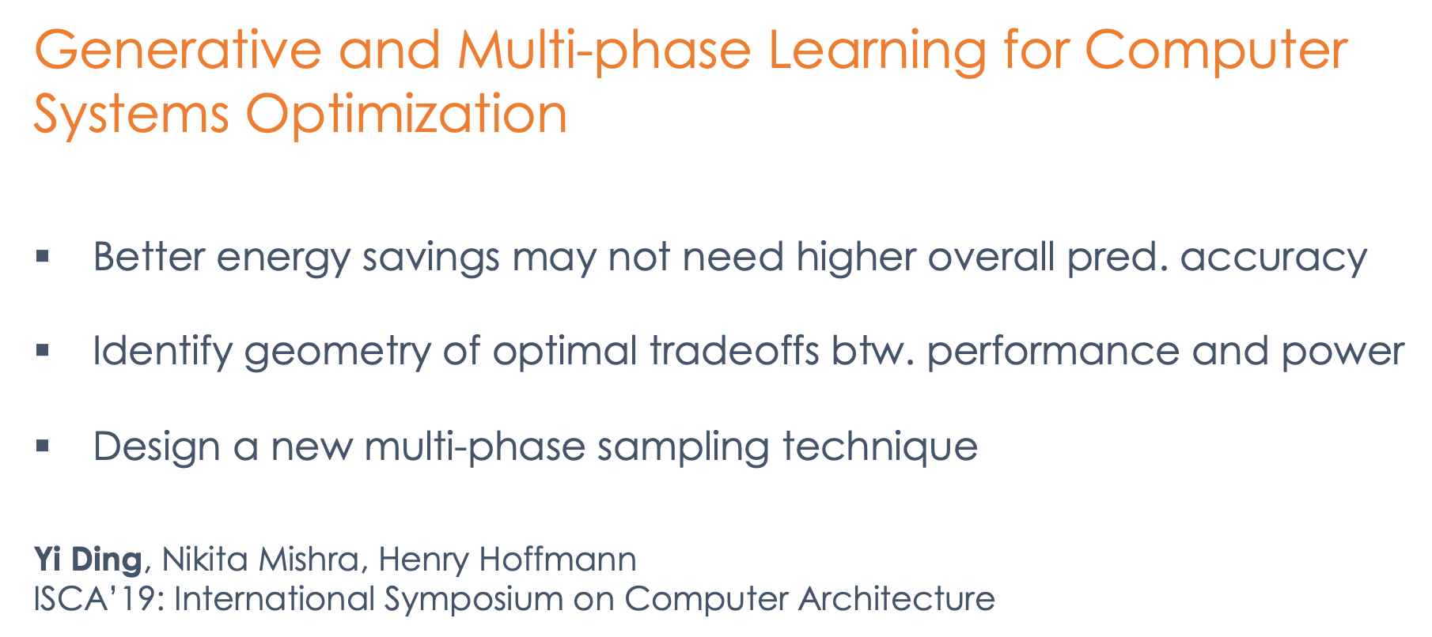
Generative and Multi-phase Learning for Computer Systems Optimization
Better energy savings may not need higher overall pred. accuracy
Identify geometry of optimal tradeoffs btw. performance and power
Design a new multi-phase sampling technique
Yi Ding, Nikita Mishra, Henry Hoffmann
ISCA’19: International Symposium on Computer Architecture
Notes:
This is some energy minimization work I did a couple of years ago at ISCA. The main goal of this work is to demonstrate that better energy savings does not necessarily need higher overall prediction accuracy for performance and power. Instead, I designed a new sampling technique that incorporates the geometry of optimal tradeoffs in the performance and power tradeoff to design a new multi-phase sampling technique to trade overall prediction accuracy for reduced energy consumption.

Slide 14
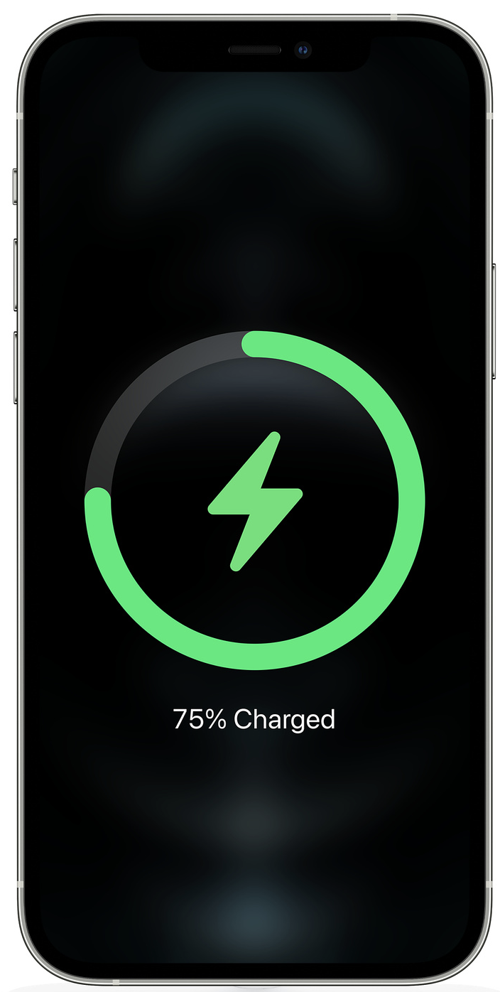
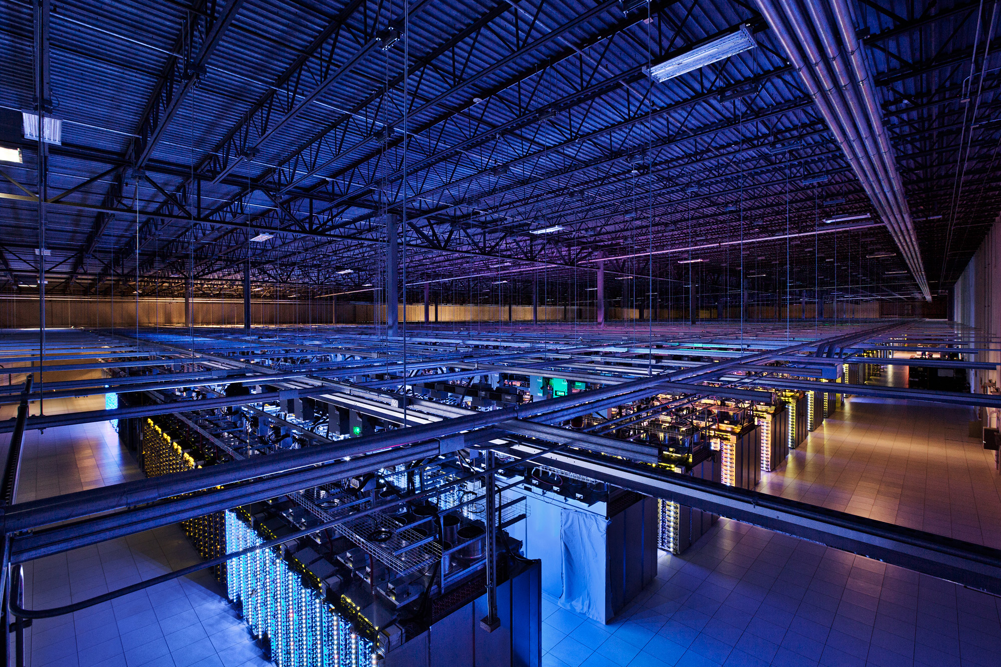
Energy
Notes:
Modern computing systems are constrained by energy consumption, from the mobile devices to servers in datacenters.

Slide 15
Minimize Energy under Performance Constraints
An allocation of hardware resources to the application e.g., cores, clockspeed, etc.
Minimize
s.t.
Configuration
SRAD Application on ARM big.LITTLE System

Slide 16
Minimize Energy under Performance Constraints
An allocation of hardware resources to the application e.g., cores, clockspeed, etc.
Minimize
s.t.
Configuration
Theory:
The energy-optimal solution needs two configurations.
These configurations must lie on the optimal frontier (lower convex hull). ¹
Optimal Frontier
Observations:
Most (>90%) configurations are not on the optimal frontier.
The optimal frontier is unknown for a new application.
SRAD Application on ARM big.LITTLE System
1. D. H. K. Kim, C. Imes, and H. Hoffmann. Racing and pacing to idle: Theoretical and empirical analysis of energy optimization heuristics. CPSNA’15.
Notes:
Second, the optimal frontier is unknown for a new application unless we measure performance and power for all configurations for this application. However, it can be very time-consuming and expensive. In our experiments, for many applications, it took as days to measure performance and power for all configurations for just one application. Therefore, instead of measuring for all configurations, we want to sample a small amount of configurations to find a near optimal solution.

Slide 17
How do we sample configurations on the optimal frontier when the optimal frontier is unknown?
Predict Optimal Frontier
Sample From It
Multi-phase Sampling

Slide 18
Learning Problem Setup
Predict Performance and Power for Configurations
Known Applications
New Application
Existing Learning Methods:
Matrix Completion (ASPLOS’13, 14)
Hierarchical Bayesian Method (ASPLOS’15, MICRO’17, ASPLOS’18)
Configurations
Unknown value
Measured value
Predicted value
18

Slide 19
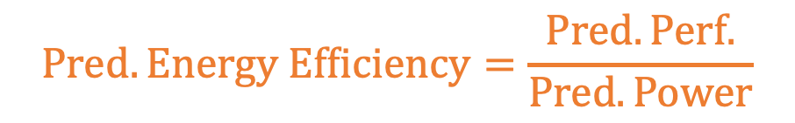
Multi-phase Sampling
$$Pred. Energy Efficiency=\frac{Pred. Perf.}{Pred. Power}$$
Total #Configurations: M= 8
Sampling Budget: N = 4
New Application
1st Phase: Uniform
2nd Phase: Selective
Known Applications
0
1
3
2
5
3
2
Configurations
4
5
6
6
1
7
4
Unknown value
Measured value
Predicted value
19
Notes:
For the 1st phase. When the new app comes, we do not have any knowledge about this application, so we want to explore. What we do is ordering the configurations from the least resource usage to the maximum resource usage, and then uniform sample 2 configurations from the ordered configuration list such that the selected configurations can spread the entire configuration space as much as possible. And then, we measure performance and power for the 2 configs.

Slide 20
Phase-1: Uniform Sampling

Slide 21
Phase-2: Selective Sampling

Slide 22
Evaluation Methodology
 | Mobile | Server
System | Ubuntu 14.04 | Linux 3.2.0
Architecture | ARM big.LITTLE | Intel Xeon E5-2690
# Applications | 21 | 22
# Configurations | 128 | 1024
Parameters | big/LITTLE cores, clockspeed | #sockets, #memory controllers, #cores/socket, hyperthreading, clockspeed, TurboBoost
Sample Budget | 20 | 120
Baseline: Random Sampling (ASPLOS’13, ASPLOS’14, ASPLOS’15, MICRO’17, ASPLOS’18)
Learning Methods: 4 Matrix Completion Methods, 1 Hierarchical Bayesian Method
Open-source Resource Scheduler: Performance with Optimal Energy Toolkit (POET)

Slide 23
Evaluation Results
Improvements of Multi-phase Sampling over Random Sampling in Energy Savings, Prediction Accuracy in Performance, and Prediction Accuracy in Power.
Significant better energy savings, but trivial improvements or even degradation in prediction accuracy.
Higher is better
Notes:
I show the improvement results of Multi-phase Sampling over Random Sampling in Energy Savings, Prediction Accuracy in Performance, and Prediction Accuracy in Power, so higher value is better. First, let’s see energy savings. On both mobile and server systems, MP has 41% and 11% more energy savings than RS. However, when we look the prediction results for performance and power, the prediction accuracy improvement comparing MP to RS is trivial, and even degradation on server. To summarize, our results show that MP has significant better energy savings, but trivial improvements or even degradation in prediction accuracy for performance and power.

Slide 24
Optimal Frontier Predictions
Notes:
To understand why this happens, I visualize the prediction results of optimal frontier from different methods. I show two application examples from each system: the left is SRAD on mobile, the right is HOP on server. In each figure, I show the true optimal frontier, and optimal frontiers predicted by RS and MP. We can see that OFs predicted from MP are much closer to the true OF. This explains why MP has significant better energy savings because it focuses on improving prediction accuracy for configurations around OF. However, as I mentioned earlier, most (>90%) configurations are not on the optimal frontier. When the learning model is optimized for overall accuracy, it gets the biggest win by improving accuracy for these configurations that are not on the OF since they are the majority, which does not improve the systems result.
HOP, a density-based data clustering, from MineBench
SRAD, Rodinia

Slide 25
Cost Structure and Tradeoffs
Observe
ML Methods
Optimize
Intervene
Trade model accuracy for reduced data collection
Trade overall model accuracy for improved energy savings
Cost Structure: Not All Configurations are Equally Useful
Notes:
Finally, let’s see what tradeoffs in the ML for systems pipeline I make in this work. First, Second.

Slide 26
My Research
First-authored Papers
Co-authored Papers
Multi-phase Sampling
[ISCA’19]
Today’s Talk
ML for Systems Thrust
Energy
Neural Surrogates
[Onward’21]
NURD
[MLSys’22]
Cello
[Arxiv’22]
CAFQA
[ASPLOS’23]
Meet System Goals
Performance
GIL+
[ESEC/FSE’21]
Interpretability
Saxon
[Arxiv’22]
Acela
[Arxiv’22]
Reliability
Fundamental ML Thrust
SDCA
[AAAI’14]
AdaOAM
[AAAI’15]
Kernel OAM
[ICDM’17]
MKA
[NeurIPS’17]
CCM+SCM
[AISTATS’20]
NPVAR
[NeurIPS’20]
Minimax
[Biometrika’22]

Slide 27
NURD: Negative-Unlabeled Learning for Online Datacenter Straggler Prediction
Introduce online straggler prediction without prior knowledge
Characterize the dissimilarity btw. running & finished tasks
Develop a reweighting strategy to reduce prediction bias
Yi Ding, Avinash Rao, Hyebin Song, Rebecca Willett, Henry Hoffmann
MLSys’22: Conference on Machine Learning and Systems
Notes:
I’m going to talk about NURD, Negative-Unlabeled Learning for Online Datacenter Straggler Prediction. The main goal of this work is to introduce a new problem of online straggler prediction without any prior knowledge. To address this problem, I characterize the dissimilarity between running and finished and develop a reweighting strategy to reduce prediction bias for stragglers. Before diving into the technical details, I hope we are on the same page about what a datacenter is and how computation works in datacenters.

Slide 28

https://www.racksolutions.com/news/blog/how-many-servers-does-a-data-center-have/
Notes:
A datacenter is a building, or a designated space within a building that houses a group of networked computer servers. Modern internet services are deployed on hyperscale datacenters that include millions of servers.

Slide 29
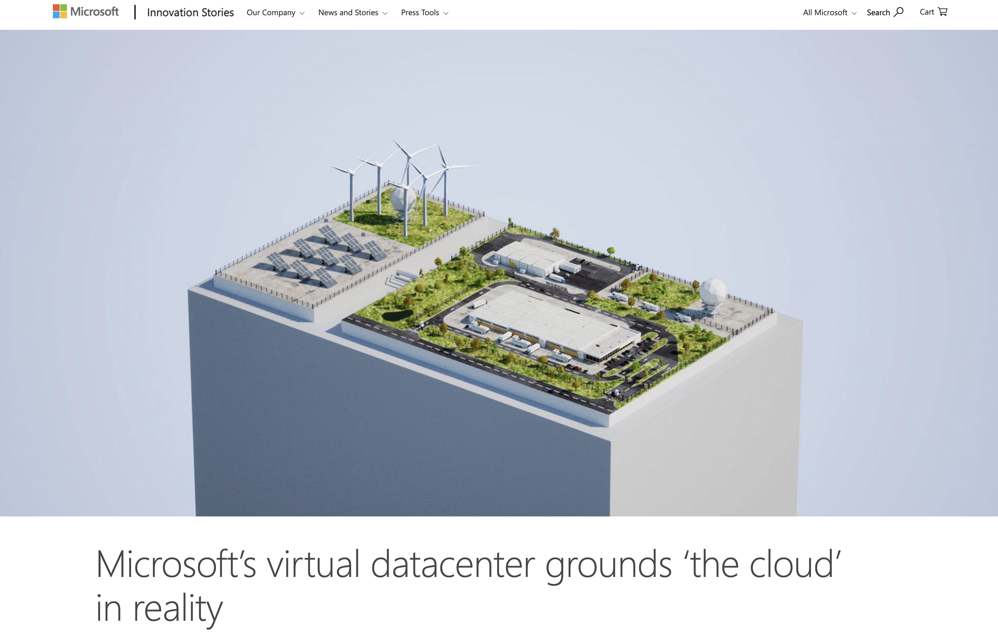



Notes:
Big tech companies have spent billions of dollars building their own datacenter infrastructure to support their business, and they are still building more.

Slide 30
Datacenter Computation
Task Parallelism
A job is split into parallel tasks that execute on different machines.
Job completion time depends on the slowest task.
Job
Full Data
Partitions
Task1
Task2
Task3
Notes:
Datacenter executes large computation jobs that process a large amount of data. Oftentimes the data that a job needs to process is too large to be stored in a single machine. So the data is divided into partitions that are managed and processed in separate machines, which we call them tasks. Datacenters split a job into many tasks and execute them in parallel on many machines, and aggregate results when the last task completes. In other words, the job completion time depends on the slowest task.

Slide 31
Stragglers
Stragglers
Rare, but extremely slow tasks within a job, e.g., > P90.
Root causes include load imbalance, resource constraints, scheduling, etc.
Impact: Delay job completion time by 50% in 20% of Google jobs.
A Job Split into Tasks
⎯ Nominal
⎯ Straggler
Tasks
Threshold
Execution Time
Notes:
Stragglers are rare, but extremely slow tasks within a job. For example, if 95% of tasks within a job have been completed, the remaining 5% unfinished tasks are stragglers. A variety of root causes can lead to stragglers such as load imbalance, resource constraints, scheduling issues, etc. Stragglers have a negative impact on datacenter computations. For example, when we look at a Google production system, we found that completion time for 20% of jobs were extended by 50% or more.

Slide 32
Straggler Mitigation
Speculative Execution
Monitor job execution and launch duplicates of slow tasks.
Need to predict stragglers early and accurately.
Node A
Task Progress
Task
(slow)
Scheduler
Node B
Task (duplicate)
Launch Speculative
Notes:
To improve the efficiency of datacenter computation, we must mitigate stragglers. One of the most widely used mitigation strategies is speculative execution, which is also what we did in our evaluation. Speculative execution is to monitor the progress of job execution and launch duplicates of tasks that are observed or predicted slower. The key of speculative execution is to identify stragglers as early as possible so that we can launch duplicates as early as possible to save more time. Therefore, for straggler mitigation, the fundamental challenge is how to predict stragglers early and accurately, which is what we study in this work.
speculative execution means that the system doesn't try to fix slow tasks as it is hard to detect the reason (misconfiguration, hardware issues, etc), instead, it just launches another parallel/backup task for each task that is performing slower than the expected, on faster nodes.

Slide 33
Offline Straggler Prediction
Offline Straggler Prediction
Predict task latency based on task and node features using prior knowledge
Limitations
Long data collection time: Wait for stragglers to occur to include both stragglers and nonstragglers in training
Generalizability issue: No guarantee that model trained on previous jobs can generalize to new jobs
Notes:
The definition of straggler prediction problem is to predict task latency based on task and node features such as resource usage, scheduling behavior, machine capacity, microarchitectural features, etc. Prior work that uses ML to predict stragglers focuses on offline straggler prediction, which needs to rely on lots of prior knowledge. The limitations of offline straggler predictions are two-fold. First, it requires long data collection time because stragglers occur much later than nonstragglers. Second, there is no guarantee that the model trained on previous jobs can generalize to new jobs.

Slide 34
Can we predict stragglers without relying on labeled stragglers or other jobs?
Notes:
So given these limitations, can we….?

Slide 35
Online Straggler Prediction
Online Straggler Prediction
Predict task latency based on task and node features on-the-fly w/o prior knowledge
Benefits
Collect data and train model on-the-fly: No need to wait for stragglers to occur
Only use data from the current job: No reliance on other jobs
Notes:
To address this problem, I present a new problem setting of online straggler prediction. Different from offline straggler prediction, we can predict stragglers on the fly without relying on any prior knowledge. Specifically, online straggler prediction collects data and trains model on-the-fly, meaning that we do not need to wait for stragglers to occur. Instead, we predict stragglers shortly after the job starts executing. Also, we only rely on the data collected from the current running job.

Slide 36
Illustration of Online Straggler Prediction
A Running Job Split into 16 Tasks
Epoch | Finished Tasks (Labeled) | Running Tasks (Unlabeled)
t₀ | 1,8,10,14 | 0,2,3,4,5,6,7,9,11,12,13,15
t₁ | 1,3,5,8,9,10,11,12,14 | 0,2,4,6,7,13,15
t₂ | 0,1,3,4,5,7,8,9,10,11,12,14 | 2,6,13,15
t₃ | 0,1,2,3,4,5,7,8,9,10,11,12,14,15 | 6,13
0
1
2
3
4
5
6
7
8
9
10
11
12
13
14
15
⎯ Nominal
⎯ Stragglers
Tasks
0
t₀
t₁
t₂
t₃
Threshold
When a task is predicted to straggle, it could trigger straggler mitigation.
Execution time
Goal: Build a unique latency predictor for each job on-the-fly w/o prior knowledge
Notes:
Let me use some illustrations to help you setup the problem of online straggler prediction. In this example, a running job is split into 16 tasks that start executing in parallel. Online straggler prediction monitors the task executions and predict stragglers at each time interval. For example, at time t0, the finished…are, the running tasks are…. Online straggler prediction will train on the labeled finished tasks and unlabeled running tasks to predict which running tasks’ latency will exceed the target threshold. If any task is predicted to exceed the target threshold, it is predicted as a straggler and some straggler mitigation operation will be triggered. So to summarize, the goal of online straggler prediction is to ….

Slide 37
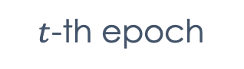
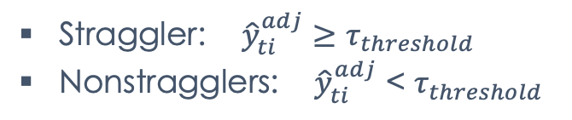
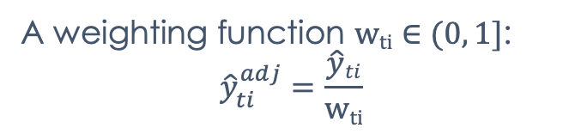
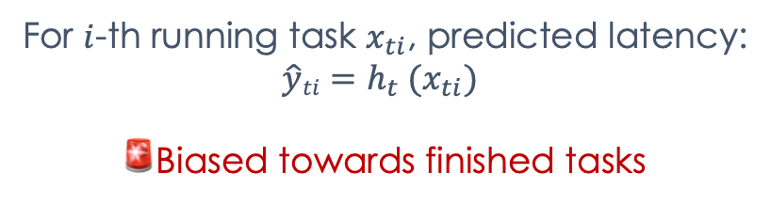
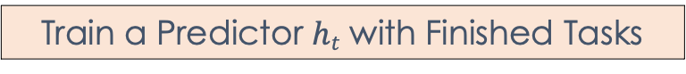
NURD
Key idea: train a latency predictor using finished tasks and reweight predictions based on a function of dissimilarity between finished and running tasks
e₀
e₁
e₂
e_{i}
Train
Reweight
Train
Reweight
Train
Reweight
Train
Reweight
$t$-th epoch
Train a Predictor $ht$ with Finished Tasks
Reweight Predictions
For $i$-th running task $x_{ti}$, predicted latency:
$$\hat{y}ti=h_{t} (x_{ti})$$
🚨Biased towards finished tasks
A weighting function $wti∈(0, 1]$:
$${\hat{y}}_{ti}^{adj}=\frac{\hat{y}ti}{wti}$$
Straggler: ${\hat{y}}_{ti}^{adj}$ $≥$ $τ_{threshold}$
Nonstragglers: ${\hat{y}}_{ti}^{adj}$ < $τ_{threshold}$

Slide 38
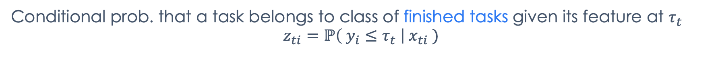
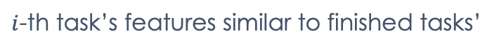


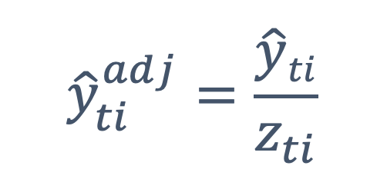
Propensity Score
Conditional prob. that a task belongs to class of finished tasks given its feature at $τ_{t}$
$$z_{ti}=ℙ\left( y_{i}≤τ_{t} \right|{ x}_{ti} )$$
By logistic regression
Task ID | Class | Propensity Score
0 | Finished | 0.95
1 | Running | 0.65
2 | Finished | 0.9
3 | Running | 0.8
4 | Running | 0.4
$${\hat{y}}_{ti}^{adj}=\frac{\hat{y}ti}{z_{ti}}$$
$i$-th task’s features different from finished tasks’
$i$-th task’s features similar to finished tasks’
0
$$zti$$
1
More likely to straggle, ${\hat{y}}_{ti}^{adj}$ $≫\hat{y}ti$
More likely to finish soon, ${\hat{y}}_{ti}^{adj}$ $≈\hat{y}ti$
Notes:
To find this weighting function, we think of PS.

Slide 39

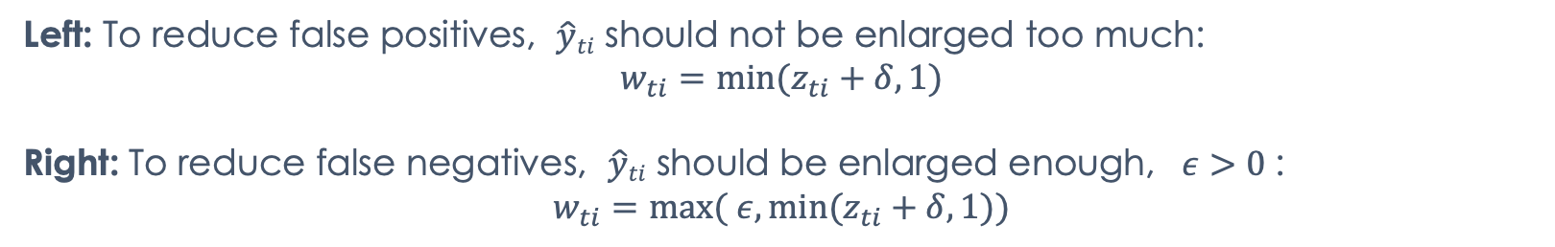
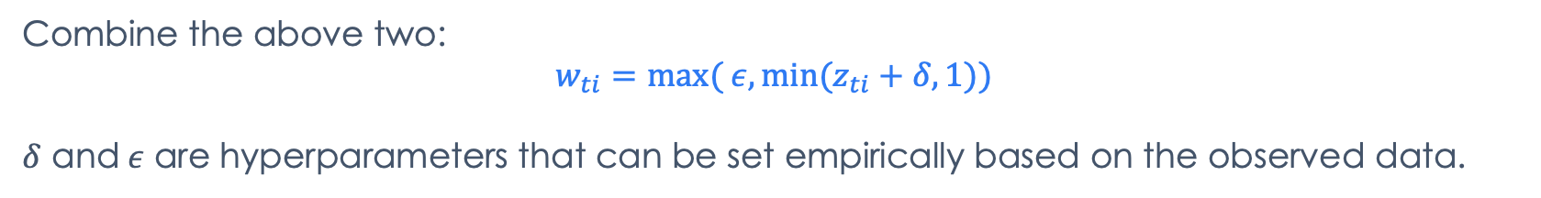
Weighting: PS & Calibration
---- 0.5 ---- Latency Threshold P90
Left: To reduce false positives, $\hat{y}ti$ should not be enlarged too much:
$$w_{ti}=\min{(z_{ti}+δ, 1)}$$
Right: To reduce false negatives, $\hat{y}ti$ should be enlarged enough, $ε>0$:
$$w_{ti}=\max{( ε,min⁡(z_{ti}+δ, 1))}$$
Combine the above two:
$$w_{ti}=\max{( ε,min⁡(z_{ti}+δ, 1))}$$
$δ$ and$ε$ are hyperparameters that can be set empirically based on the observed data.

Slide 40

Evaluation Methodology
Integrate Predictions with Speculative Execution Scheduler
Max & Mean CPU Usage
Max & Mean Memory Usage
Page Cache Memory Usage
Max & Mean Disk I/O
Local Disk Space Used
Cycles Per Inst.
Memory Accesses Per Inst.
# Tasks Evicted
# Tasks Fail
Node A
Task Progress
Task
(slow)
Scheduler
Node B
Time Series Features
Task (duplicate)
Launch Speculative
Points of Comparison
1 Generic Regression: GBT | Censored & Survival Regression
14 Outlier Detection Methods | Wrangler (SOCC’14)
2 Positive-Unlabeled Methods | NURD: GBT + Reweighting
Max & Mean CPU Usage
Max & Mean Memory Usage
Notes:
Explain that only Wrangler is the system baseline that is used for offline straggler prediction. Other baselines are ML methods that have never been used in straggler prediction.
We test on a wide range of latency threshold from P70 to P99

Slide 41
Evaluation Results
Improvements of NURD over Best Baselines for Each Dataset in F1, Job Completion time, and Task Latency Prediction Accuracy.
Improvements in straggler prediction and mitigation, but decreases in latency prediction accuracy.
Higher is better

Slide 42
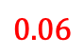
Trading Prediction Accuracy for System Goal
Latency Predictions for a Straggler in Google Trace
0.78
True Latency
0.1
NURD Prediction
0.88
0.72
$$0.06$$
Baseline Prediction
Threshold: 0.75
Normalized Execution Time
Notes:
This example demonstrates that we should focus on improving system outcome, instead of the accuracy of ML predictions.

Slide 43
Cost Structure and Tradeoffs
Observe
ML Methods
Optimize
Intervene
Trade model architecture for reduced data collection and generalizability
Trade task latency prediction accuracy for improved straggler prediction and mitigation results
Cost Structure: Asymmetric Costs between Under- and Overprediction
Notes:
What model architectures we cannot use?

Slide 44

My Research
First-authored Papers
Co-authored Papers
Multi-phase Sampling
[ISCA’19]
Today’s Talk
ML for Systems Thrust
Energy
Neural Surrogates
[Onward’21]
NURD
[MLSys’22]
Cello
[Arxiv’22]
CAFQA
[ASPLOS’23]
Meet System Goals
Performance
GIL+
[ESEC/FSE’21]
Interpretability
Saxon
[Arxiv’22]
Acela
[Arxiv’22]
Reliability
🏆 Meta Research Award
🚄 Production in Meta Datacenters
Fundamental ML Thrust
SDCA
[AAAI’14]
AdaOAM
[AAAI’15]
Kernel OAM
[ICDM’17]
MKA
[NeurIPS’17]
CCM+SCM
[AISTATS’20]
NPVAR
[NeurIPS’20]
Minimax
[Biometrika’22]
Notes:
Before moving on to future directions, I’d like to highlight my external engagement work Acela in meeting reliability goal.
In this work, I introduce a new research problem called maintenance job scheduling that has not received much attention in academic circles. In datacenters, servers must be maintained regularly to guarantee system reliability. To automate the maintenance process for hundred of thousands of servers, each server is expected to complete the assigned maintenance jobs within a strict time budget so that the datacenter capacity is maximized. To improve the efficiency of maintenance job scheduling, I design a ML system that uses quantile regression to predict maintenance job durations. The most interesting part about this work is that this system problem has asymmetric costs between under- and overprediction. Because oversubscribing a server has negative impacts on datacenter capacity, the job duration predictor should overpredict to avoid violating the time constraint. When comparing our system to other systems that focus on improving prediction accuracy of job durations, our technique achieved high datacenter capacity despite relatively lower overall prediction accuracy of job durations. This work is currently deployed at real-world datacenters to improve maintenance efficiency of millions of servers. This is another evidence that system outcome is more than prediction accuracy. We should make proper tradeoffs to benefit computing systems.

Slide 45
What are the fundamental challenges in ML for Systems?
Notes:
Be more foundational. Should be a stand.

Slide 46
Future Directions: Rethinking Computer Systems from Causal Perspectives
Evaluate system outcomes unbiasedly when controlled experiment is not available
Build causal models that permit observational studies
Answer counterfactual questions using log data
Uncover causality in systems when interference and unobserved confounders exist
Build causal models that incorporate domain expertise in computing
Develop new intervention strategy for causal discovery
Notes:
Given my experience in causal inference work in fundamental ML and statics, I am passionate in transfer my knowledge in causal inference to solve systems problems.
Cross-architecture performance prediction (XAPP) using CPU code to predict GPU performance (MICRO’15)

Slide 47
Future Directions: Sustainability and Climate in Computing
Explore the tradeoffs between carbon, energy, performance, and reliability
Characterize, model, and predict such tradeoffs
Develop related APIs and tools to explore tradeoffs
Design carbon-efficient computing infrastructure and applications
Enable carbon-aware computing and temporal workload shifting
Manage resources in the case of variable capacity and load flexibility
Notes:
Many corporations and governments have announced aggressive goals for reducing, and ultimately eliminating carbon footprints over the next decade. However, many of the technologies necessary to achieve these sustainability goals have yet to be developed

Slide 48
Perspective and Contributions
A Holistic View: Look at the Whole Process Altogether
Introduce a holistic view on ML for systems instead of treating each step in isolation.
Understanding cost structure of systems problems enables making better tradeoffs.
Principled methods of optimizing systems effectively and efficiently.

Slide 49
Backup Slides

Slide 50
Acela: Predictable Datacenter-level Maintenance Job Scheduling
Introduce maintenance job scheduling
Identify asymmetric costs btw. under- and overprediction
Develop an automated maintenance job scheduling system deployed in datecenters
Yi Ding, et al.
Arxiv’22 (Under Submission)
Notes:
In this work, I introduce a new research problem called maintenance job scheduling that has not received much attention in academic circles. The most interesting part of this problem is that, there also exist asymmetric costs btw. under- and overprediction for job durations. To account for the asymmetric cost, I develop a quantile regression-based ML system that is currently being deployed in meta datacenters to improve the maintenance efficiency of millions of servers.
In datacenters, servers must be maintained regularly to guarantee system reliability. To automate the maintenance process for hundred of thousands of servers, each server is expected to complete the assigned maintenance jobs within a strict time budget so that the datacenter capacity is maximized. To improve the efficiency of maintenance job scheduling, I design a ML system that uses quantile regression to predict maintenance job durations. The most interesting part about this work is that this system problem has asymmetric costs between under- and overprediction. Because oversubscribing a server has negative impacts on datacenter capacity, the job duration predictor should overpredict to avoid violating the time constraint. When comparing our system to other systems that focus on improving prediction accuracy of job durations, our technique achieved high datacenter capacity despite relatively lower overall prediction accuracy of job durations. This work is currently deployed at real-world datacenters to improve maintenance efficiency of millions of servers. This is another evidence that system outcome is more than prediction accuracy. We should make proper tradeoffs to benefit computing systems.

Slide 51

https://www.dorsalys.com/en/references/mbda-maintenance-operation-contract-datacenter
Notes:
In datacenters, servers must be maintained regularly to guarantee system reliability and reduce likelihood of future faults. To automate the maintenance process for millions of servers, datacenter operators need to make sure that each server is expected to complete the assigned maintenance jobs within a strict time budget so that the datacenter capacity is maximized.

Slide 52




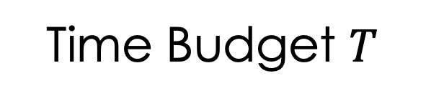
Maintenance Job Scheduling
Goal: Decide max. # maintenance jobs that can complete within time budget
Challenges: 1) Job durations are unknown before execution
2) Oversubscribing a server reduces datacenter capacity
Time Budget $T$
Schedule A
Job 1
Job 2
Job 3
Schedule B
Job 1
Job 3
Acela 🚄
Use quantile regression that models high quantiles to overpredict job durations
Notes:
This problem is called maintenance job scheduling. The goal is to decide the maximum number of jobs that can complete within the time budget for each server. The asymmetric cost in this problem is that oversubscribing a server actually reduces datacenter capacity. Let me use an example of 2 schedules to demonstrate this. Assuming the time budget is T for a server, schedule A assigns 3 jobs to this server, the total job durations exceeds T, which means that the server cannot finish all jobs before the time budget expires, so this is a bad outcome. In contrast, schedule B assigns 2 jobs to this server, and the server can finish executing the 2 jobs within the time budget, so this is a good outcome.
To account for such asymmetric costs, I design a ML system called Acela that predict job durations before scheduling to aid decision-making. The key insight of ML technique for Acela is to use quantile regression that models high quantiles to overpredict job durations to avoid oversubscribing servers.

Slide 53
Evaluation Results
Improvements (X) of Acela over Baseline ML Systems that maximize prediction accuracy in #Servers out of Production (SOR), Server Downtime (SDT), and Job Duration Prediction Accuracy.
Improvements in datacenter capacity, but decreases in job duration prediction accuracy.
Higher is better
Notes:
We evaluate on job duration data collected from real production systems at Meta datacenters. We compare Acela to other baseline ML systems that maximize the prediction accuracy for job durations. We evaluate the results in 3 different metrics, SOR, SDT, and job duration prediction accuracy. SOR and SDT are metrics of datacenter capacity. We can see that compared to the baseline systems, Acela has significant improvements in SOR and SDT. What is really interesting is that Acela has lower prediction accuracy that the baseline system.
To summarize, Acela achieves high datacenter capacity despite relatively lower overall prediction accuracy of job durations. This is another evidence that system outcome is more than prediction accuracy, and we should make proper tradeoffs to maximize system benefits.

Slide 54
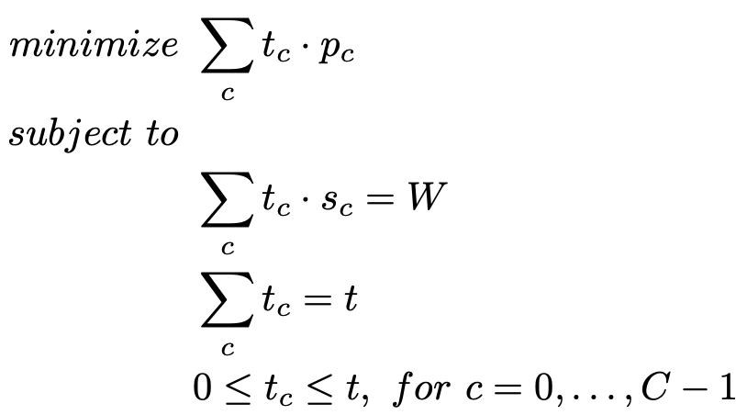
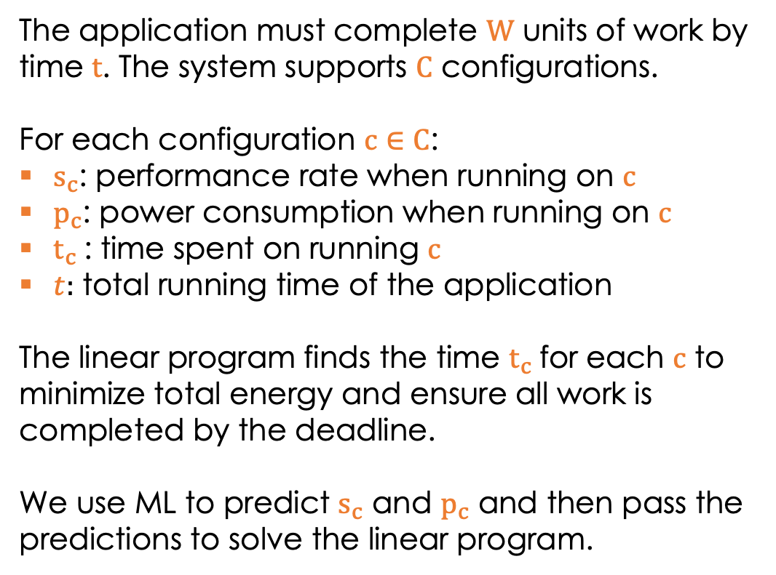
Minimize Energy under Performance Constraints
The application must complete $W$ units of work by time $t$. The system supports $C$ configurations.
For each configuration $c∈$ $C$:
$s_{c}$: performance rate when running on $c$
$p_{c}$: power consumption when running on $c$
$t_{c}$: time spent on running $c$
$t:$ total running time of the application
The linear program finds the time $t_{c}$for each $c$ to minimize total energy and ensure all work is completed by the deadline.
We use ML to predict $s_{c}$ and $p_{c}$ and then pass the predictions to solve the linear program.
General formulation that can be applied to many applications and systems

Slide 55
Applications for ISCA’19
Benchmarks drawn from Parsec, Rodinia, ParMiBench, MineBench
Example of Applications for Mobile
All 4 threads
Example of Applications for Server
All 32 threads
Category | Application
Video encoding | x264
Route planning | bfs
Encryption | sha
Signal processing | lud
Image processing | srad
Video analytics | bodytrack
Machine learning | backprop, kmeans
Category | Application
Data analytics | apr, btree, hop
Machine learning | kmeans, svmrfe, nn
Search webserver | Swish++
Scientific computing | cdf
Notes:
In our experiments we consider only a single, multi-threaded application at a time. Whether on mobile or server, our goal is to meet an application latency target with minimal energy by configuring system resources appropriately. Given the latency requirements, we currently consider a single application at a time and leave multi- programmed scheduling for future work.
HOP, a density based clustering method

Slide 56
Configuration Space
Server systems: 16 cores, 2 hyperthreads, 2 memory controllers, and 16 speed settings (15 DVFS settings + TurboBoost)
Mobile system: 4 big cores support 19 clockspeeds, and 4 LITTLE cores support 13 clockspeeds

Slide 57
Illustration of Configuration Ordering
Core | Hyperthreading | Memory Controller | Clockspeed
0 | 0 | 0 | 0
0 | 0 | 0 | 1
0 | 0 | 0 | 2
0 | 0 | 0 | 3
0 | 0 | 1 | 0
0 | 0 | 1 | 1
0 | 0 | 1 | 2
0 | 0 | 1 | 3
0 | 1 | 0 | 0
0 | 1 | 0 | 1
0 | 1 | 0 | 2
0 | 1 | 0 | 3

Slide 58
Number of Optimal Configurations
Mobile
Server

Slide 59
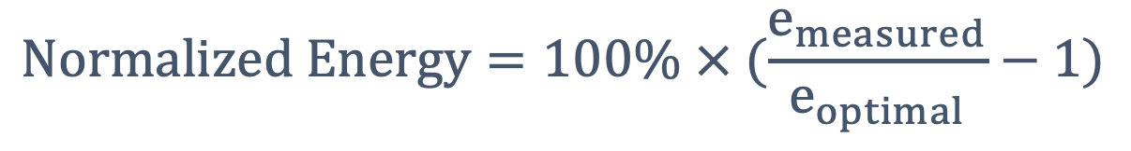
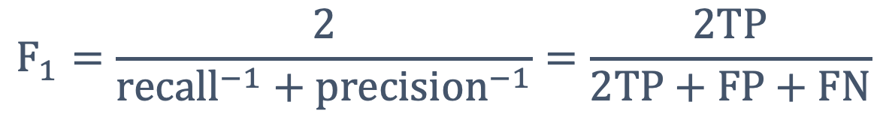
Evaluation Metrics
Energy consumption is measured as
$$Normalized Energy=100\% × (\frac{e_{measured}}{e_{optimal}}−1)$$
F1 score is the harmonic mean of precision and recall
$$F_{1}=\frac{2}{{recall}^{−1}+{precision}^{−1}}=\frac{2TP}{2TP+FP+FN}$$

Slide 60
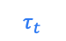
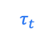
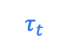
Illustration of Predicting and Reweighting
Finished Tasks Running Tasks
0
1
2
3
4
5
6
7
0
1
2
3
4
5
6
7
0
1
2
3
4
5
6
7
Tasks
After Predicting
Tasks
After Reweighting
Tasks
0
$$τ_{t}$$
Threshold
0
$$τ_{t}$$
Threshold
0
$$τ_{t}$$
Threshold
Execution time
Execution time
Execution time
Notes:
To find this weighting function, the first step is to use PS.

Slide 61
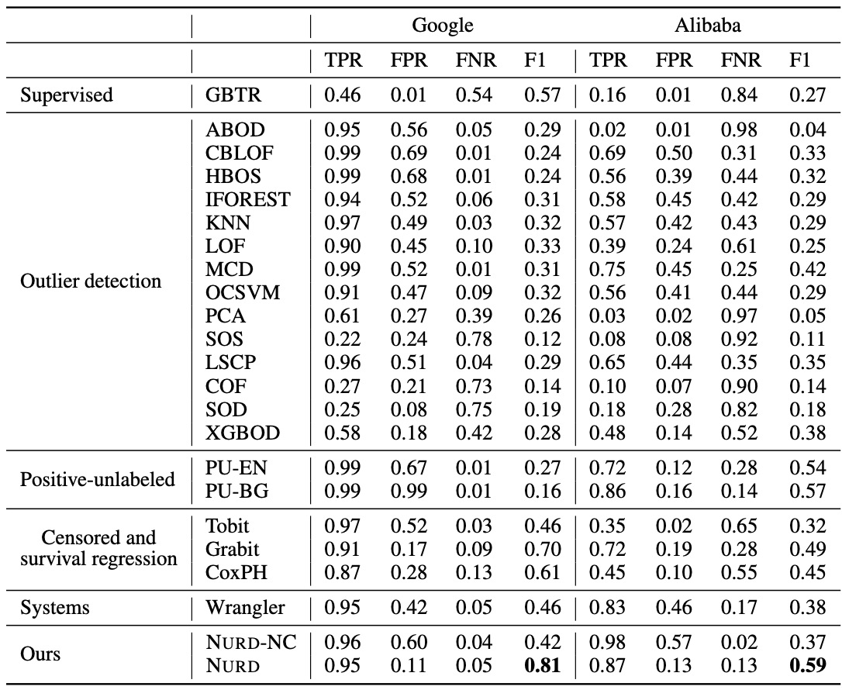
Averaged results over all jobs for Google & Alibaba datasets

